Slide 1

Rats without Hats
Justin Cropsey
David Gordon
Su Timurturkan
CS 4641 Machine Learning
Professor Rodrigo Borela
Georgia Tech

Slide 2
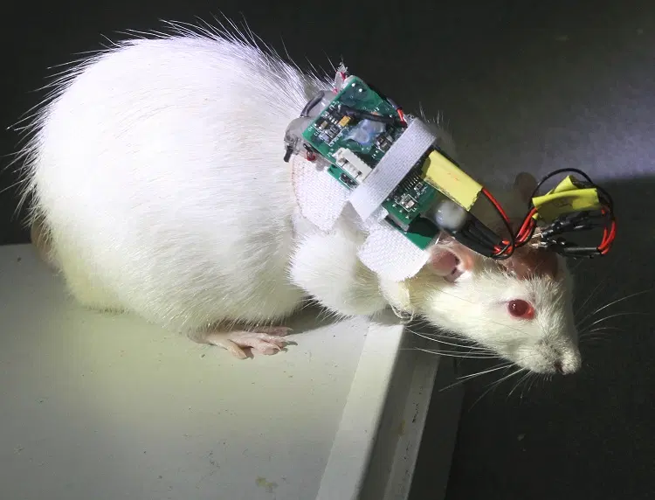
A Bumpy Start
Visual Evoked Potentials (VEP)
In vivo recordings
Allen Brain Observatory
Determine what the rat was observing
Too complicated for time allotted

Slide 3
New Beginnings
Sohel Rana’s Parkison’s Disease Classification (Kaggle)
754 dimensions per sample
Various speech measurements
Binary sex classification
3 samples per individual
756 samples total
252 individuals
64 unaffected people
188 affected people
74.6% probability of being affected from inclusion in study

Slide 4
Parkinson’s Disease
Progressive neurodegenerative disorder
Member of Lewy Body Dementias
Along with Dementia with Lewy Bodies
Plaques in the brain (Lewy Bodies)
α-synuclein protein
Diagnosis is difficult
Biopsy is off limits
SPECT and DaTscan (both CT scans) are expensive
Goal
Low-cost, minimally invasive technique to diagnose PD based on speech characteristics

Slide 5
Unsupervised Learning
K-means (Scikit-Learn)
Elbow Analysis (Yellowbrick)
k = 2
Gaussian Mixture Model (GMM) (Scikit-Learn)
PCA (170 components) (Scikit-Learn)
95% of explained variance
K-Means
GMM
Ten-bin Histogram (Matplotlib)
5-component PCA

Slide 6
Supervised Learning
Gaussian Naive Bayes (GNB) (Scikit-Learn)
Neural Net (Keras and TensorFlow)
Sequential w/ 3 Dense Layers
Sigmoid Activation
Problems:
Unscaled data -> Oscillations in accuracy between epochs
Overfitting -> 100% accuracy in training
Synthetic Minority Oversampling Technique (SMOTE)
Oversample minority to equalize representation
100-component PCA
Random Forest

Slide 7
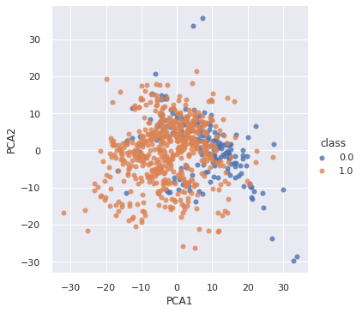
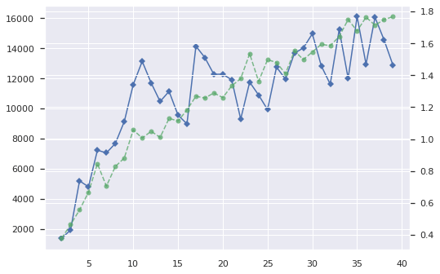
Results

Slide 8
Discussion
K-Means performed best (17.8%:19.6% unaffected:affected above chance)
GMM resulted in nonprobabilistic results
PCA
Showed divergence in mean
Required 170 components to account for 95% of variance
Supervised learning was at or below chance
GNB, NN, and Random Forests performed similarly
Neither PCA nor SMOTE affected the results
Intra-person variance is smaller than inter-person variance

Slide 9
Conclusions
Lot of diversity in manifestation of speech characteristics w/ PD
The data set was simply too small to capture this diversity
Larger data set could make ML viable for diagnosing PD
Many features showed differences in mean and st. dev.
Manually develop a “normal” and scorecard deviations

Slide 10
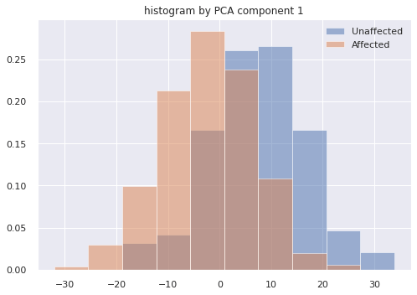
Future Work
Augment the data set
Randomize assignment of individuals to sets:
Training
Validation
Testing
Ensemble Neural Nets

Slide 11
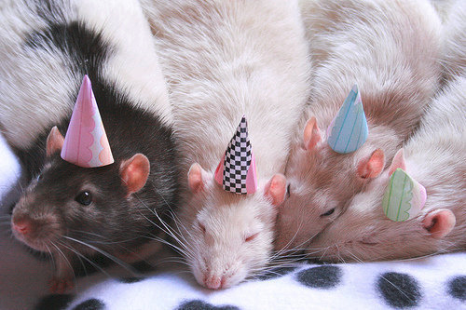
Happy Summer Break!

